Slide 1
Rate Limiting with nginx and Fail2Ban
Chris Cumming

Slide 2




Who am I? (i.e. Shameless Self Promotion)
Software Consultant https://saturdaymp.com chris.cumming@satudaymp.com Virtual Chat Host http://weeklydevchat.com/ https://www.legacycode.rocks/
Slacks Chris C on Dev Edmonton Legacy Code Rocks YegSec
Notes:
I’m a software consultant that helps small to medium sized businesses get software out the door
Any other software developers?
I’ve been working on expanding my security knowledge. I have knowledge on how to write secure software but want to expand it to servers, networks, etc.
Sub-contract with Corgibytes and one of their clients inspired this talk.
I also run and host the Weekly Dev Chat. I also co-host the Legacy Code Rocks virtual meetup.

Slide 3
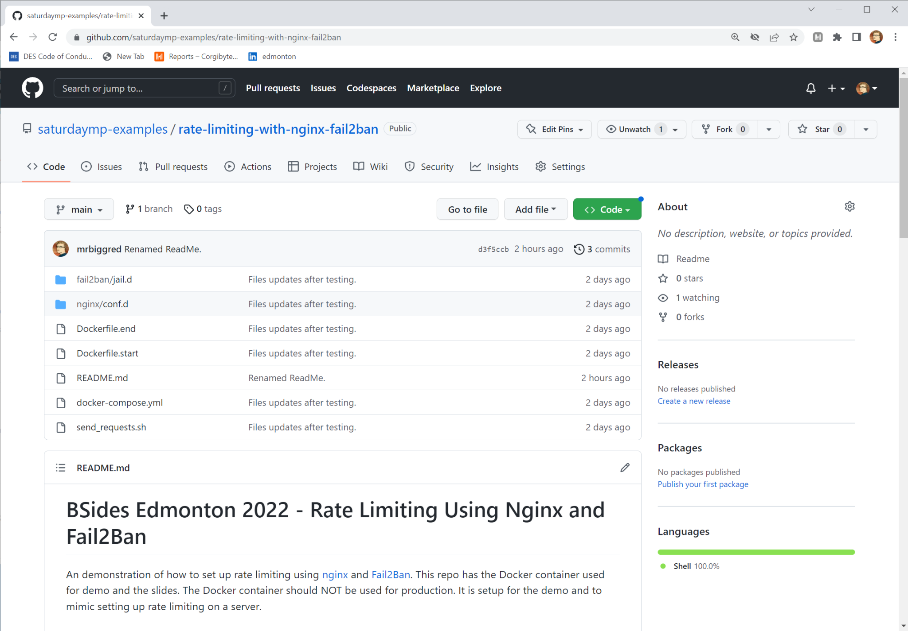
Example Repo
If you want to follow along or play experiment with rate limiting:
https://github.com/saturdaymp-examples/rate-limiting-with-nginx-fail2ban

Slide 4

What is Rate Limiting?
Rate limiting is a strategy for limiting network traffic. It puts a cap on how often someone can repeat an action within a certain timeframe – for instance, trying to log in to an account. - Cloudflare https://www.cloudflare.com/learning/bots/what-is-rate-limiting/
Notes:
Lots of connections is often bots, scripts, etc. Usually not good or not a user.

Slide 5


What is nginx and Fail2Ban
https://www.nginx.org https://www.fail2ban.org https://www.nginx.com
Notes:
nginx [engine x] is an HTTP and reverse proxy server, a mail proxy server, and a generic TCP/UDP proxy server,
Fail2ban scans log files (e.g. /var/log/apache/error_log) and bans IPs that show the malicious signs -- too many password failures, seeking for exploits, etc.
Fail2Ban works by parsing log files looking for certain messages. If it sees a X messages in a given time frame it will ban the IP via iptables.

Slide 6

Demo
https://github.com/saturdaymp-examples/rate-limiting-with-nginx-fail2ban

Slide 7
Learn More
GitHub Repo and Tutorials https://github.com/saturdaymp-examples/rate-limiting-with-nginx-fail2ban https://www.nginx.com/blog/rate-limiting-nginx/ https://rtcamp.com/tutorials/nginx/fail2ban/
Contact chris.cumming@satudaymp.com Chris C on Slack: Dev Edmonton Legacy Code Rocks YegSec

